Slide 1

Predictive analysis of acceptance of a credit card offer
Author: Douglas Kom
Date: Juin 2024

Slide 2
Introduction
I- Data mining
II- Data cleaning and preprocessing
III- Modelization
IV- Optimization and export of the model
V- Building the app, Creating the Git Repository and Deploying the Model
Conclusion

Slide 3
Introduction
Our project deals with a marketing problem in the banking field, which is knowing which customers to target to offer a given banking product. The specific case of credit cards will be the subject that we will analyze today, with the aim of identifying bank customers likely to accept a credit card offer. To answer this problem, we decided to create an algorithm which will allow us to predict the customers corresponding to this offer and likely to accept it.
The goal of this analysis will be to build a logistic regression model to be able to predict the proportion of customers subscribing to a credit card based on the data characteristics studied. But also, to understand the behavior of those who have not accepted the offer-to-offer other products that correspond to them or to improve the characteristics of the product offered.
By exploring this data, we want to better understand the elements that influence the acceptance of offers to improve future marketing campaigns and increase the satisfaction levels of this banking establishment's customers.

Slide 4
Data mining
Objective :
Understand our data as best as possible

Slide 5
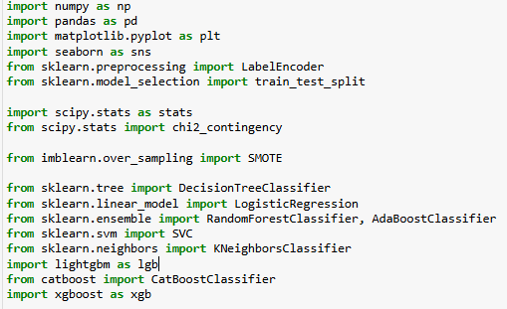
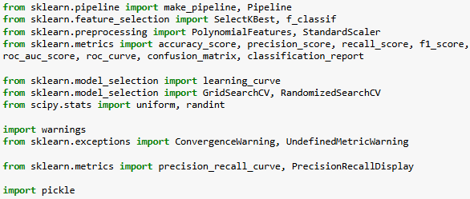
Importing Packages

Slide 6
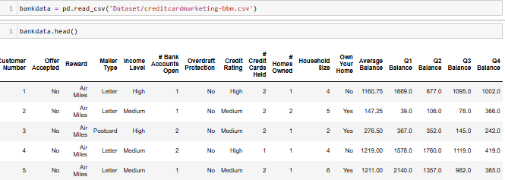
Loading Data
Data Source: https://data.world/gautam2510/credit-card-dataset

Slide 7
Data Description
The independent variables recorded for these clients are as follows:
Customer Number: Unique identifier for each customer. (Integer)
Reward: The type of reward offered with the credit card. (String)
Mailer Type: The type of mailer used to send the offer. (String)
Income Level: The customer’s income level. (String)
#Bank Accounts Open: How many bank accounts does a customer have open? (Integer)
Overdraft Protection: Whether or not a customer has overdraft protection on their account(s). (Boolean)
Credit Rating: A rating based on how well a customer's payment record reflects their ability and willingness to repay debt under terms accepted by creditors. (String)
#Credit Cards Held: How many credit cards does this user currently hold? (Integer)
#Homes Owned: How many homes does this user own? (Integer)
Household Size: Size of household that this person belongs is kept track of. (Integer)
Own Your Home: Whether or not a particular user owns their home. (Boolean)
Average Balance: Average balance across all accounts. (Float)
Q1 Balance: The customers balance in each quarter throughout an entire year. (Float)
Q2 Balance: The customers balance in each quarter throughout an entire year. (Float)
Q3 Balance: The customers balance in each quarter throughout an entire year. (Float)
Q4 Balance: The customers balance in each quarter throughout an entire year. (Float)
The target variable is:
Offer Accepted: Whether or not the customer accepted the offer. (Boolean)
This dataset ("creditcardmarketing-bbm.csv") contains the results of a credit card offer campaign carried out by a bank, with the decision that the customers of that bank made: acceptance or refusal. The overview of the structure, definition and format of the data will be presented to you below:

Slide 8
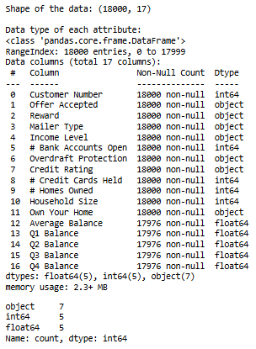
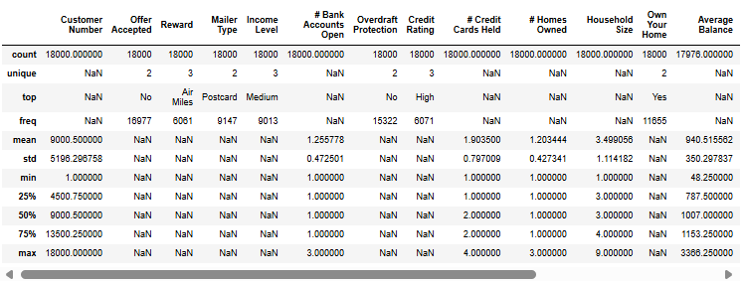
Evaluating Data Quality

Slide 9
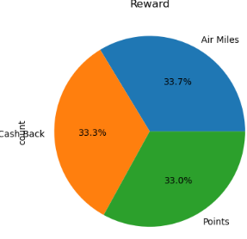
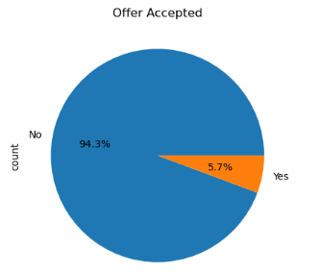
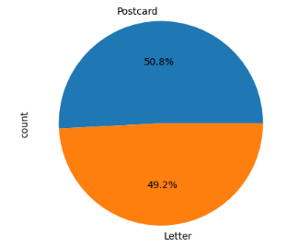
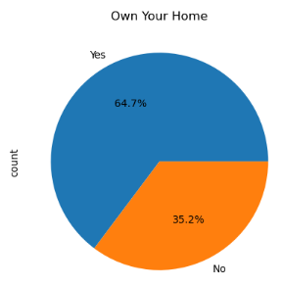
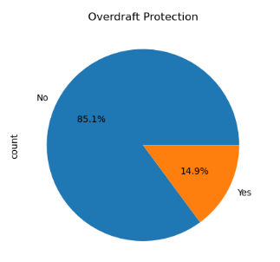
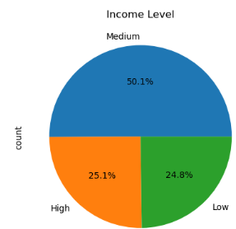
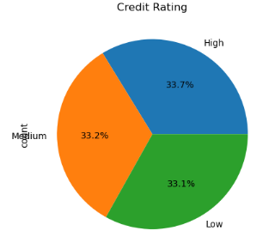
Univariate Analysis of Qualitative Variables

Slide 10
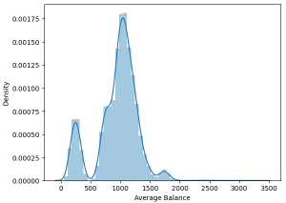
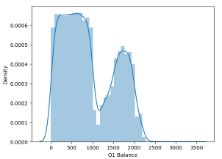
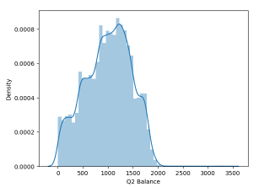
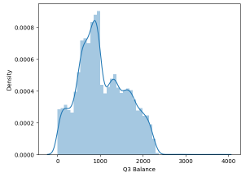
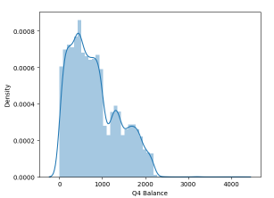
Univariate analysis of continuous quantitative variables

Slide 11
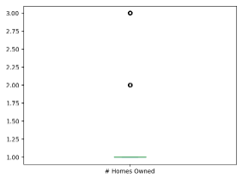
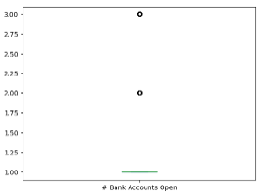
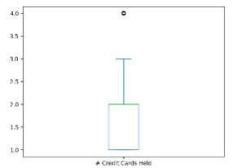
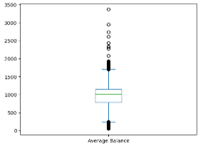
Univariate analysis of discrete quantitative variables

Slide 12
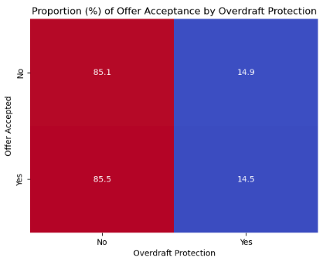
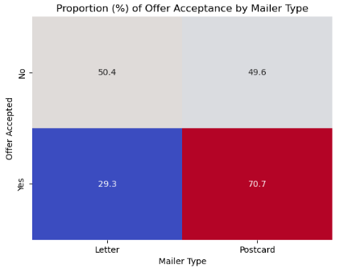
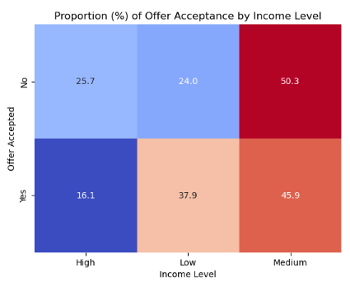
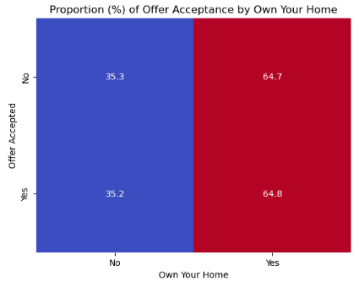
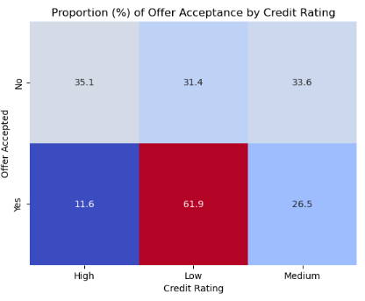
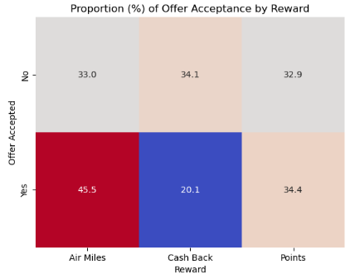
Bivariate Analysis of Qualitative Variables

Slide 13
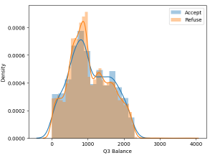
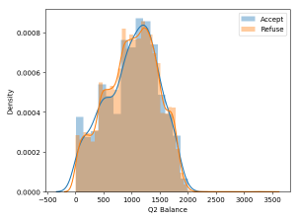
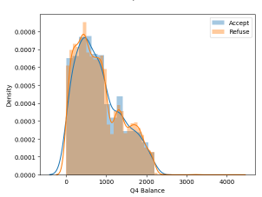
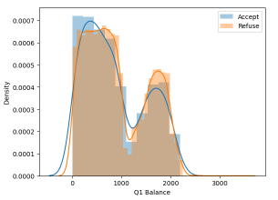
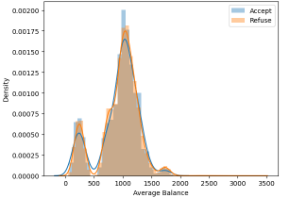
Bivariate analysis of continuous quantitative variables

Slide 14
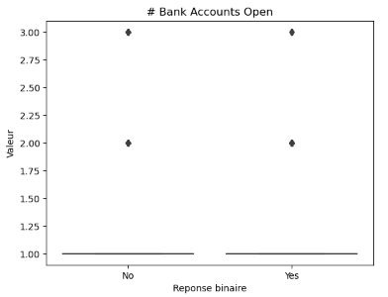
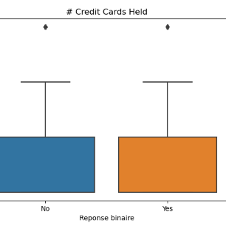
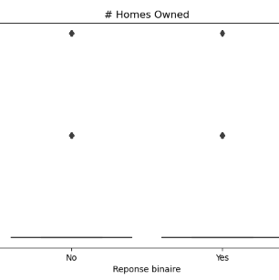
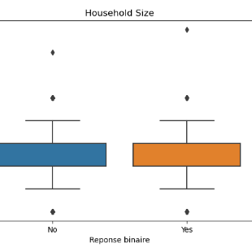
Bivariate analysis of discrete quantitative variables

Slide 15
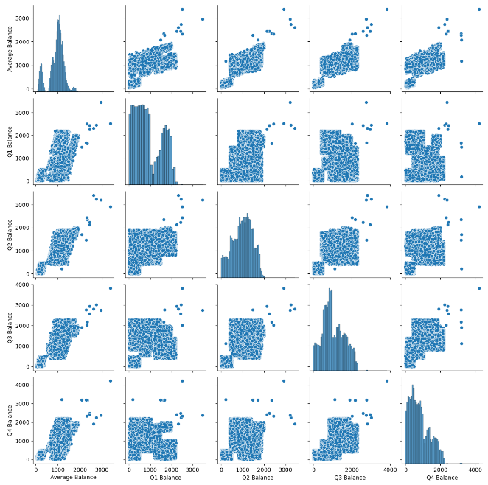
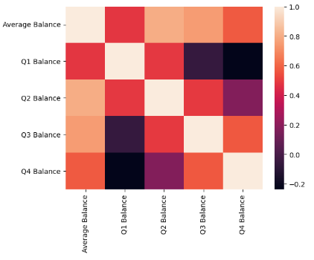
Relationship between continuous variables

Slide 16
Interpreting data mining results
Shape Analysis:
variable target: Offer Accepted
rows and columns: 18000, 17
types of variables: qualitative: 7, quantitative: 10
Analysis of missing values:
Very few missing values (less than 1%)
Background Analysis:
Visualization of the target:
6% Acceptance (1023 / 18000)
Meaning of variables:
asymmetrical, non-standardized continuous variables
quantitative variables: larger households tend to accept the offer more (hypothesis to be verified)
qualitative variables: binary (0, 1) and ternary (0, 1, 2), many own a house, many do not have an overdraft, and many have an average salary.
Variables / Target relationship:
target / continuous variables: there is no particular relationship between target variables and continuous variables
target/categorical variables: we can say that the type of reward (air mails, cash back), the mailer type (postcard) and a low credit rating improve the acceptance of the credit card offer. (Hypothesis a check)
target / discrete variables: those who have a lower bank balance tend to accept the offer (hypothesis to be verified)
More detailed analysis
Relationship Variables / Variables:
continuous variables / continuous variables: certain variables are moderately correlated: +0.5 (to be monitored later)
discrete variables / discrete variables: strongly correlated.
categorical variables / categorical variables: we observe that individuals are not divided, everyone is sure of the choice they make, and no one has to choose between one or more preferences, this could help us later to better classify individuals by categories.
NaN analysis: there are 24 nan on the 18000 lines, and its 24 nan are on the last 24 lines of the float columns variables

Slide 17
Data cleaning and preprocessing
Objective :
Delete missing values
Perform relevant statistical tests
Encode categorical variables
Standardize numerical variables

Slide 18
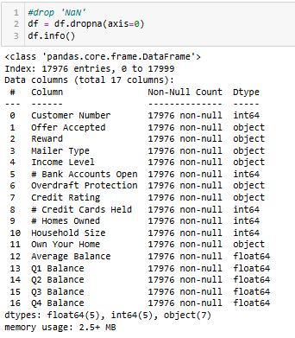
Handling missing values
we can see here that the missing values are strongly correlated with each other, because they are linked to each other, we will therefore delete them because they only represent 0.133% of the data for each variable.

Slide 19
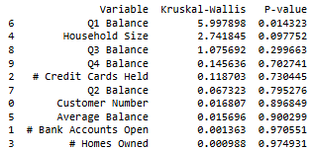
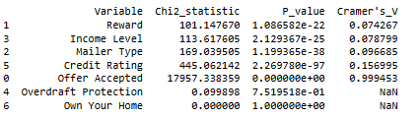
Let's confirm the hypotheses that the graphs gave us with statistical tests
This information will be useful if I need to select variables for my model.

Slide 20




Encoding categorical variables

Slide 21
Standardization
It will be applied in the next step after the data is divided into train and test.

Slide 22

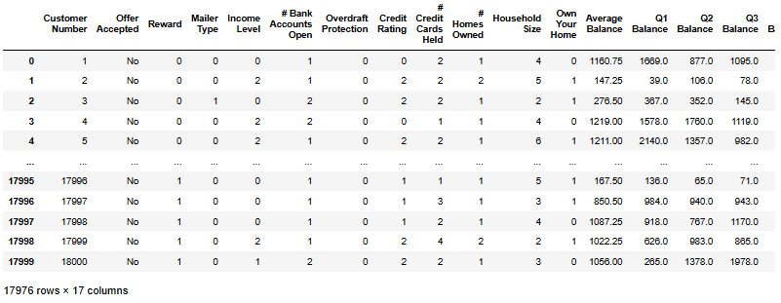
Processed Data

Slide 23
Modelization Objective :
Build a first model with the original data
Correct the Overfitting problem with balanced class weights
Correct the Overfitting problem with the SMOTE method
Choose the most efficient model to use for the optimization stage: the metric to observe is Recall (Sensitivity) because the goal of our project is to minimize false negatives, given that each customer who refuses the offer has a high cost for the company which has invested a lot of resources to put this product on the market.

Slide 24
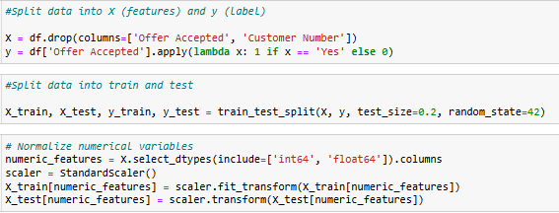
LET’S DIVIDE AND STANDARDIZE THE DATA

Slide 25
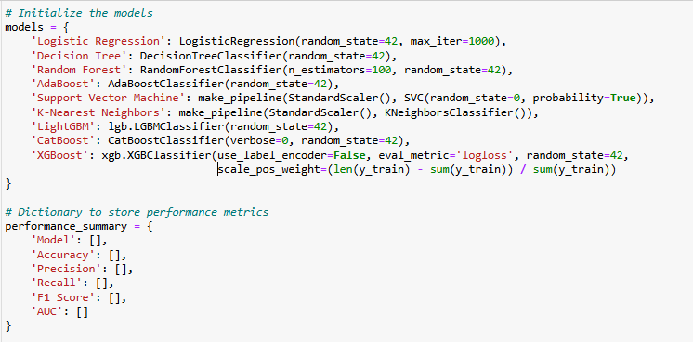
Initialize the model
Given that I am facing a classification problem with unbalanced data, here are the models that I decided to test, and the metrics that I will observe in its models to decide:

Slide 26
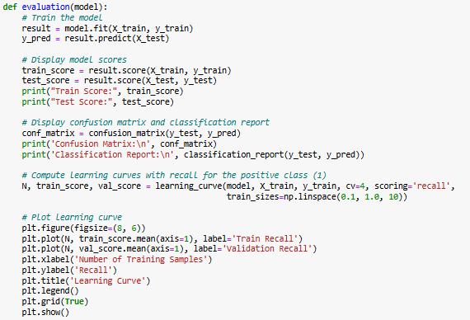
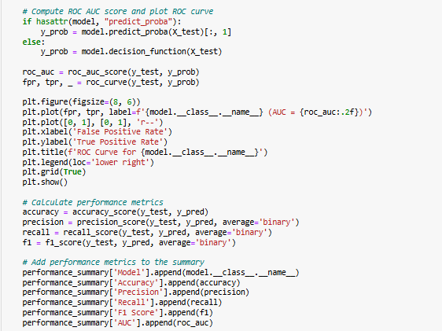
Evaluation function

Slide 27
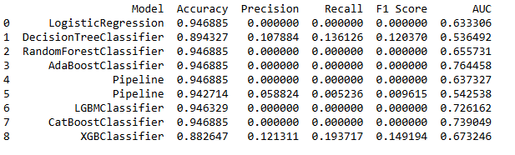
Version 1: Result of a basic modeling with preprocessed data

Slide 28
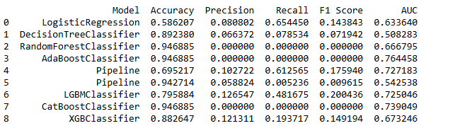
Version 2: Result of basic modeling with preprocessed data with balanced class a weights

Slide 29
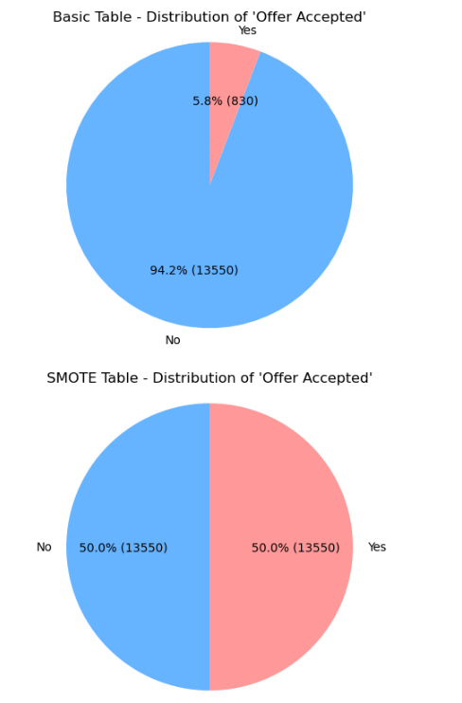
Let's balance our dataset with the Smote method

Slide 30
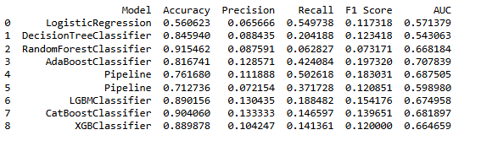
Version 3: Result of basic modeling with the SMOTE method and unbalanced classes

Slide 31

Version 4: Result of basic modeling with the SMOTE method and balanced classes

Slide 32
Interpretation
After analyzing the results obtained in the 4 versions and depending on the performance of their "recall" and their "f1score" I decided to focus more on version 2 in which the weight of each class was balance. Here are the 4 models selected to attempt optimization:
Logistic Regression (Version 2): Recall = 0.654450, F1 Score = 0.143843
Support Vector Machine (Pipeline) (Versions 2): Recall = 0.612565, F1 Score = 0.175940
LightGBM (Version 2): Recall = 0.481675, F1 Score = 0.200436
XGBoost (Version 2): Recall = 0.193717, F1 Score = 0.149194

Slide 33
Optimization and export of the model Objective :
Optimize and choose the most efficient model
Find the optimal decision threshold
Test the model with data created by us
Export the model with pickle to build the application in VScode

Slide 34


Creation of a pipeline that will select the most important variables with the polynomial function
Interpretation: Given that the goal for us is to maximize the 'recall' score, we will choose the first model which is that of logistic regression to try to improve it.

Slide 35


RandomizedSearchCV Result

Slide 36


GridsearchCV Result

Slide 37


Let's find the optimal threshold to decide
We chose the ROC curve and AUC method because the ROC curve plots the true positive rate (TPR) against the false positive rate (FPR) at different thresholds. The area under the curve (AUC) can help you choose a threshold that offers a good compromise between TPR and FPR.

Slide 38


Performance of the final model
The ROC curve and the AUC (Area Under the Curve) provide an overview of the model's ability to discriminate between positive and negative classes, in our case an AUC of 76% means that the model correctly classifies 7 clients out of 10, part of the 7 will be those who are called to accept the offer and the other part will be those who risk refusing the offer.

Slide 39

Export Model with the 'pickle' package

Slide 40
Building the app, Creating the Git Repository and Deploying the Model

Slide 41

IMPORTING ALL DATA CREATED FOR BUILDING THE MODEL

Slide 42

PREDICTION FUNCTION

Slide 43


CONSTRAINT OF THE PREDICTION FUNCTION

Slide 44
LINKS
This is the link for my app :
https://predictive-analysis-of-acceptance-a-credit-card-offer.streamlit.app/
This is the link for my GitHub repository:
https://github.com/douglaskom/credit_card_offer_acceptance_project

Slide 45
Conclusion: AUC score of 75% means that if we take 10 bank customers, the model will be able to correctly classify 7 of them.

Slide 46
Questions and Answers

Slide 47
Acknowledgements
Contact:
Email address: kombopda@gmail.com
Linkedin profil: www.linkedin.com/in/douglaskom

